Slide 1

SOFTWARE QUALITY EVALUATION
Gianluca Molteni
Mat. 730113

Slide 2
INTRODUCTION
The aim of this project is to perform a study of a dataset
HOW? Using descriptive statistics, data analysis and correlation techniques.

Slide 3
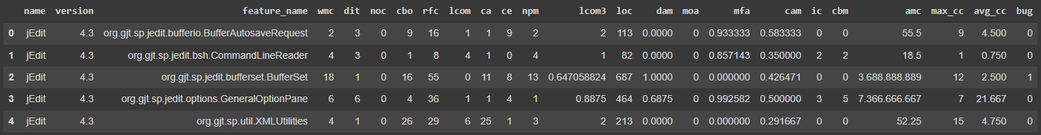
DATASET
The dataset selected is « jedit-4.3 »
Dataset dimension: 492 records and 24 attributes
No null-values
Dataset division:
Bug class | Number of elements
0 | 481
1 | 10
2 | 1

Slide 4
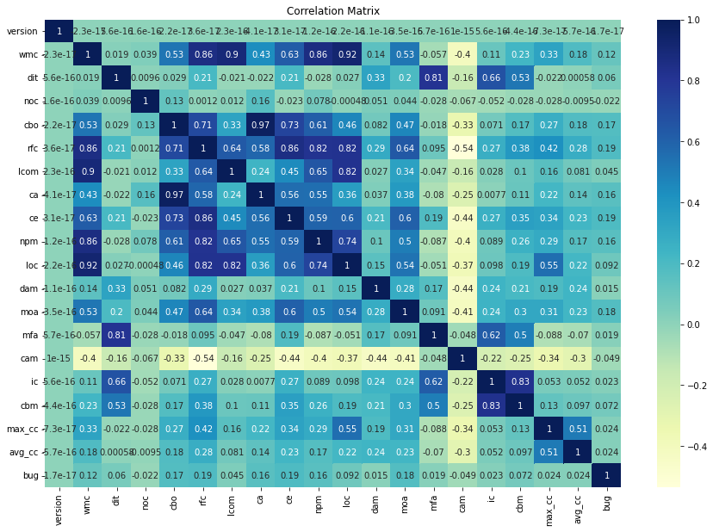
CORRELATION MATRIX
This matrix represent the correlation between features:
Greater is the color intensity, greater will be the correlation
Lower is the color intensity, lower will be the correlation

Slide 5
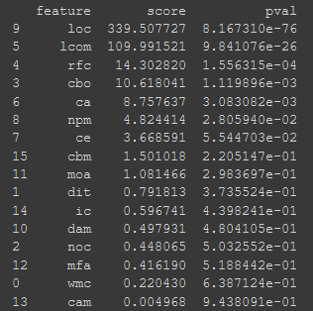
SELECT K-BEST
We select three independent variables with select k-best algorithm
K indicates the number of features that must be taken in account
Feature results are based on the chi2 value
Appling this algorithm on the dataset, we obtain:
loc – lcom – rfc like the best attributes
The table on the left summarize the k-best results,
sorted by score

Slide 6
WHAT ARE LOC, LCOM AND RFC?
loc: line of code - It is the sum of number of fields, number of methods and number of instructions
in every method of the investigated class
lcom: lack of cohesion in methods - given a class, it is the difference between the number of
pairs of methods that do not share instance variables and the number of pairs of methods that do share instance variables, if this difference is not negative
rfc: response for a class - The RFC metric measures the number of different methods that can be
executed when an object of that class receives a message.

Slide 7
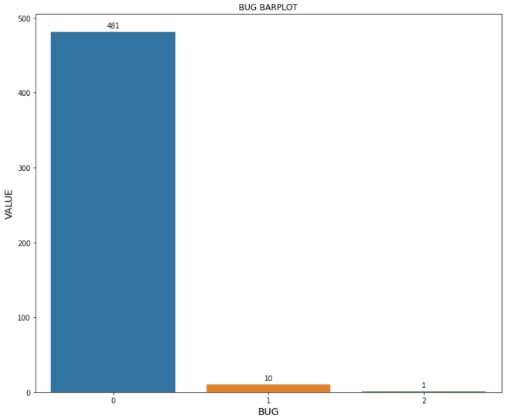
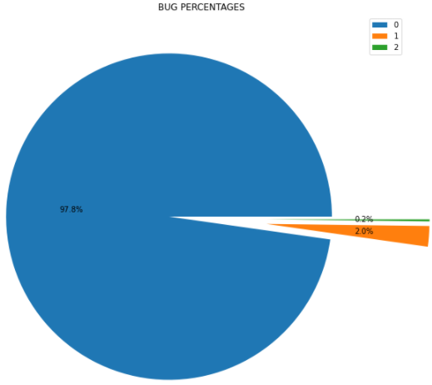
GRAPH VISUALIZATION

Slide 8
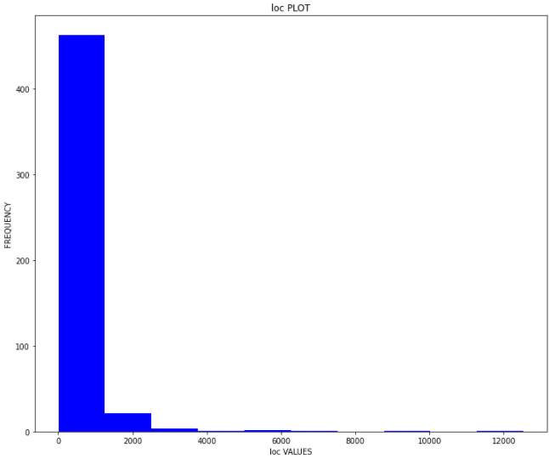
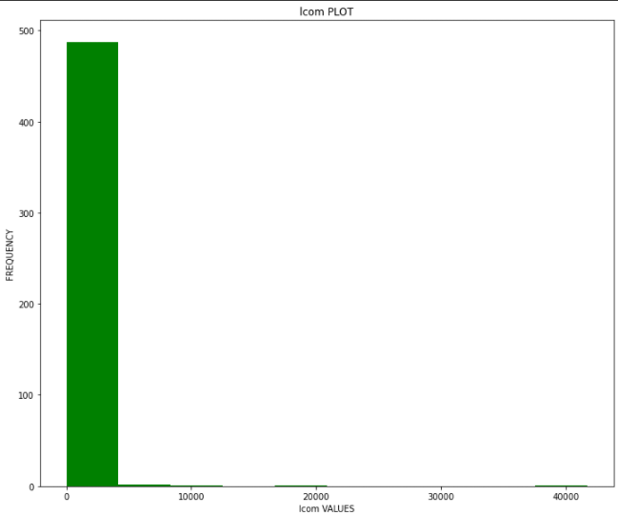
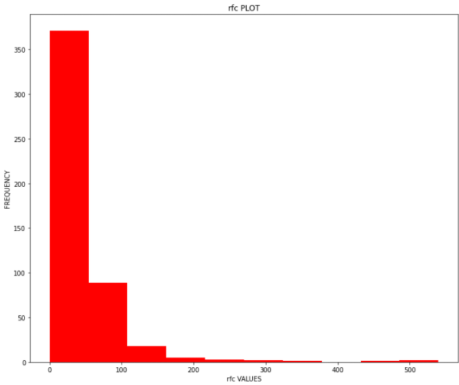
HISTOGRAMS

Slide 9
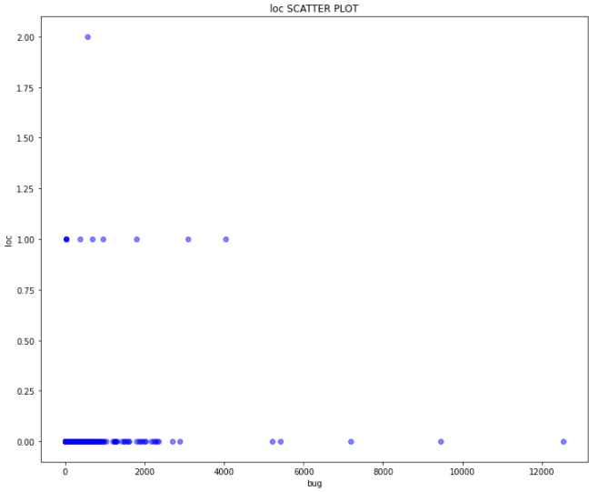
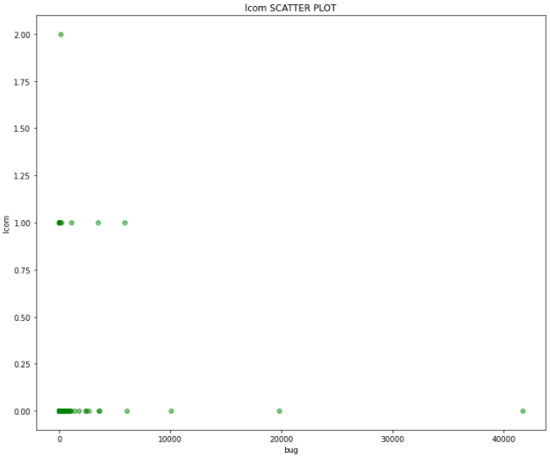
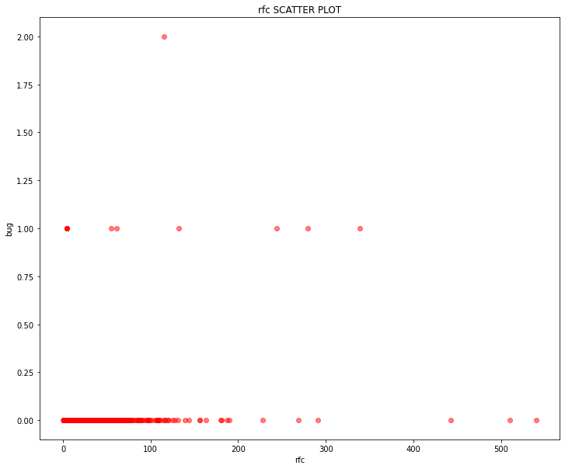
SCATTER PLOT

Slide 10
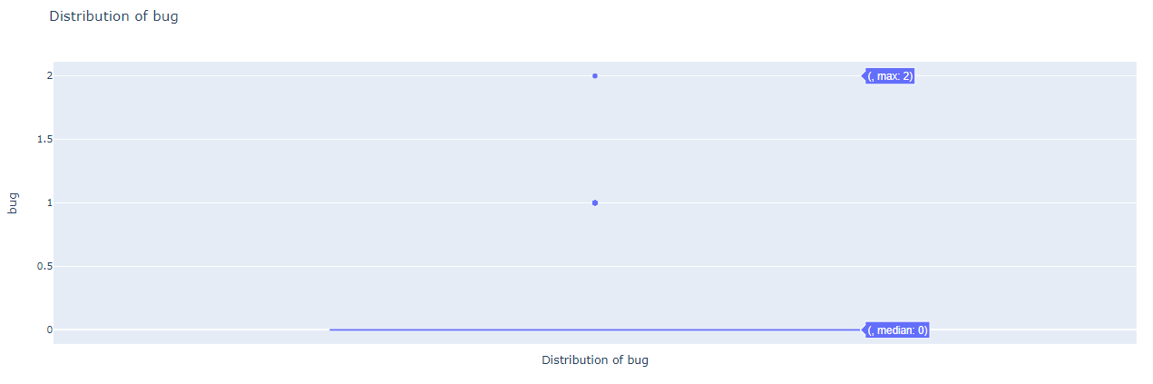
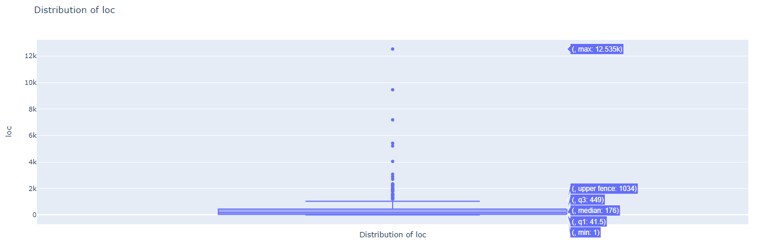
BOXPLOT

Slide 11
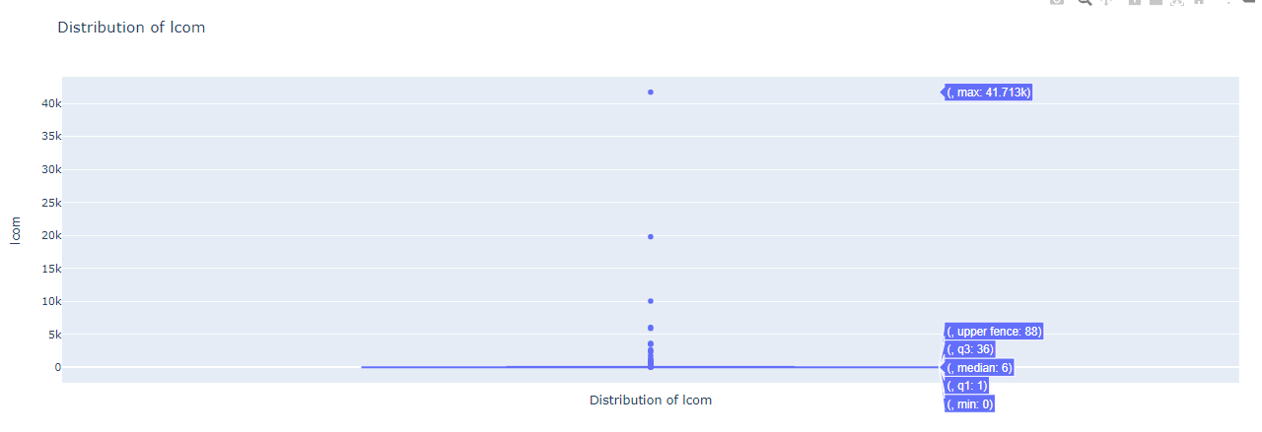
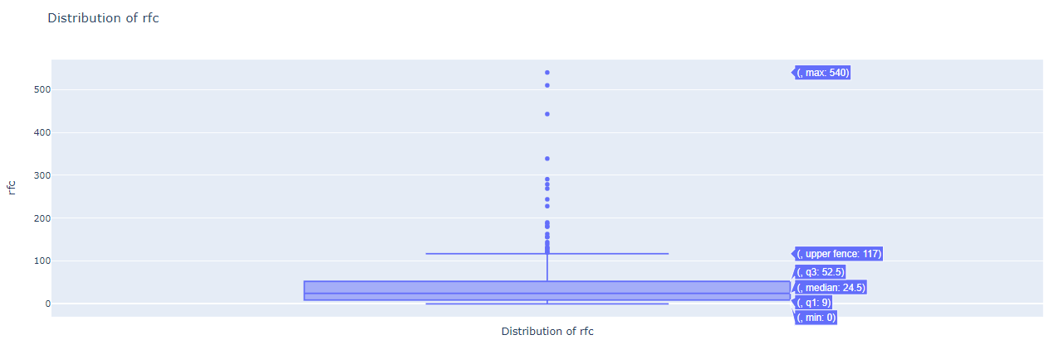

Slide 12
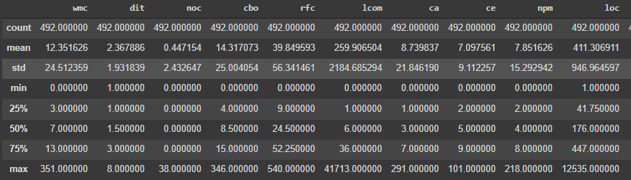
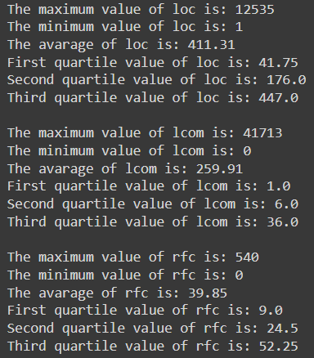
DESCRIPTIVE ANALYSIS
[Table 1]
General statistics on the original dataset(Table1) and
on the dataset derived by k-best selection (Table2)
We have some information like the minimum, maximum
and average value
[Table2]

Slide 13
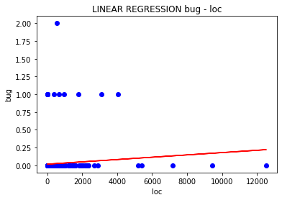
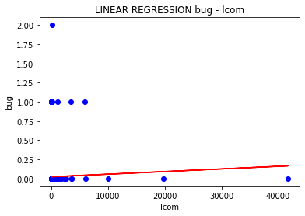
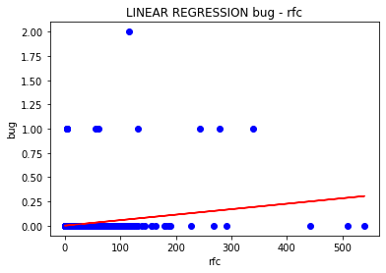
LINEAR REGRESSION
Linear regression allows to predict the value of a variable (called dependent), starting from another variable (defined independent).
We have coefficient of determination (R²), the slope and the intercept
The regression has general equation y = mx + q.
R² = 0,0085
y = 1,62x + 0,0176
R² = 0,002
y = 3,42x + 0,0234
R² = 0,036
y = 0,00056x + 0,0019

Slide 14
OUTLIERS MANAGEMENT
The distribution of the values is very wide, that is it has a very wide range of values.
In most cases, some of these data, are anomalies and they must be deleted in order to have
a homogeneous set of data.
We need to set an upper limit and a lower limit, called quantile, and keep only values between these
range.

Slide 15
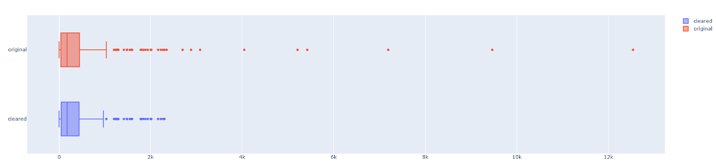
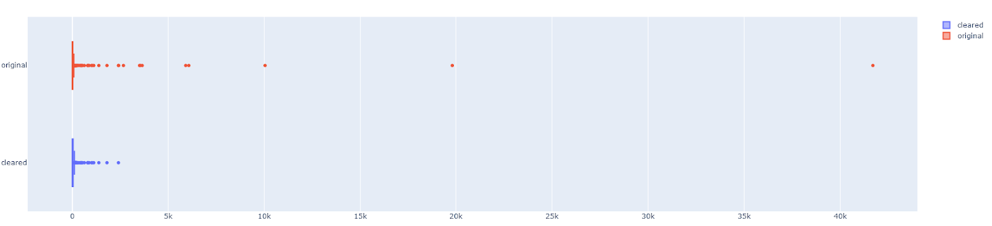
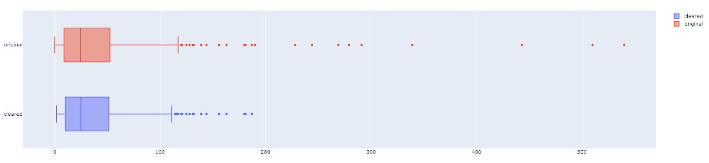
loc
lcom
rfc

Slide 16
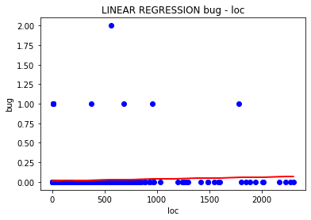
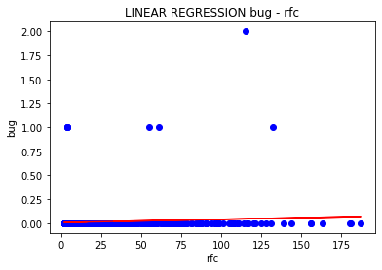
LINEAR REGESSION WITHOUT OUTLIERS
We repeat the linear regression on the dataset after the outliers removal
R² = 0,003
y = 2,41x + 0,0137
R² = 0,005
y = 5,68x + 0,0195
R² = 0,0056
y =0,00034+ 0,0074

Slide 17
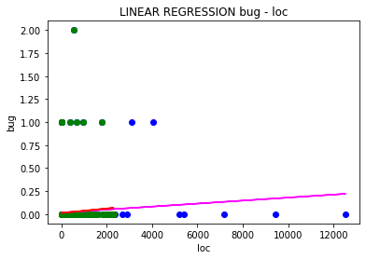
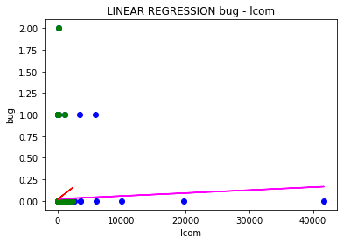
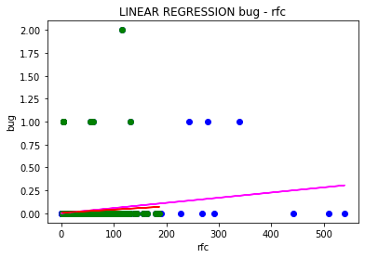
LINEAR REGRESSION COMPARISON
We compare the linear regression plot with and without outliers

Slide 18
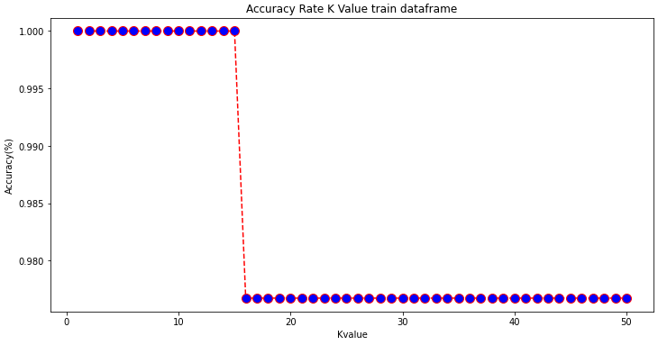
K-NEAREST NEIGHBOR (KNN)
The K Nearest Neighbor or KNN is a supervised classification algorithm that associates a given x to the class based on the quantity of elements of a given class in each range.
Given W classes and N supervised training samples. To classify a pattern x, the distance is computed (using predefined metrics) between the pattern x and k nearest samples.
Validation model
In order to evaluate the model, we take in account different information like accuracy, confusion matrix and classification report.
To find the best case and worst case, we train the model with a k in a range between 1 and 51.

Slide 19
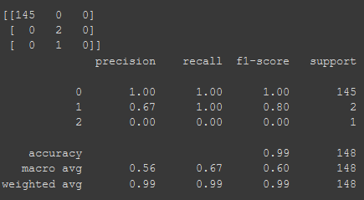
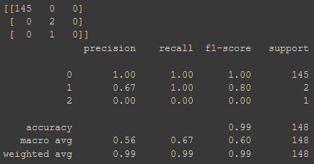
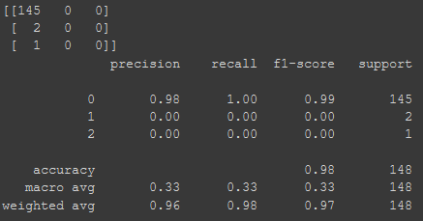
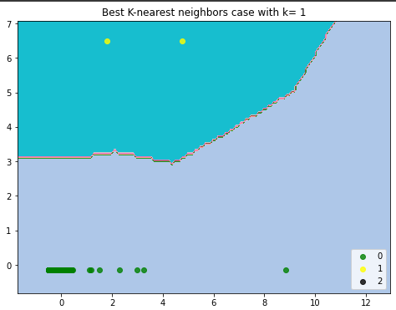
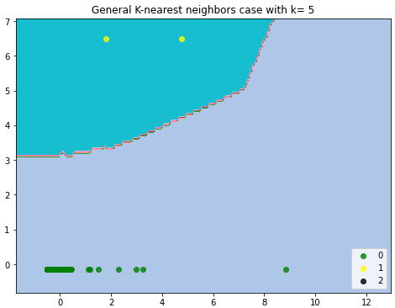
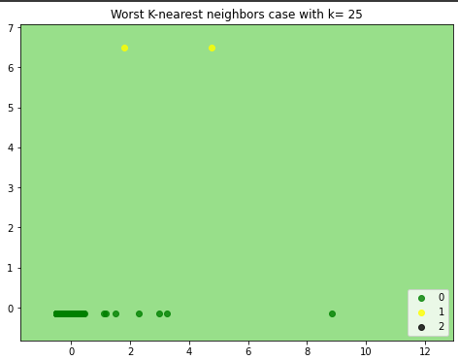
BEST CASE
GENERAL CASE
WORST CASE
k=1
k=5
k = 25

Slide 20
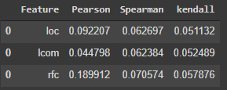
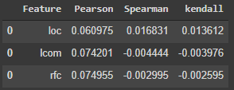
PEARSON, SPEARMAN AND KENDALL CORRELATION
We apply the Spearman, Kendall and Pearson correlation in order to evaluate the type of
correlation.
Original dataframe
Cleared dataframe
Positive correlation with Spearman
Good correlation with Pearson
Positive correlation with Kendall
Positive correlation with Pearson
Good correlation with Pearson for loc
but negative with lcom and rfc
Positive correlation with Kendall for loc
but negative with lcom and rfc

Slide 21
CONCLUSION
Summarize:
Dataset contains 492 records and 24 attributes
We have 3 bug classes
Linear regression shows us the correlation between k-best feature result and bug
KNN give us an idea on how a classification algorithm groups elements basing on existing information
Pearson, Spearman and Kendall correlation return the correlation type (positive – negative – null)
Limitation: without outliers the results change deeply

